Slide 1
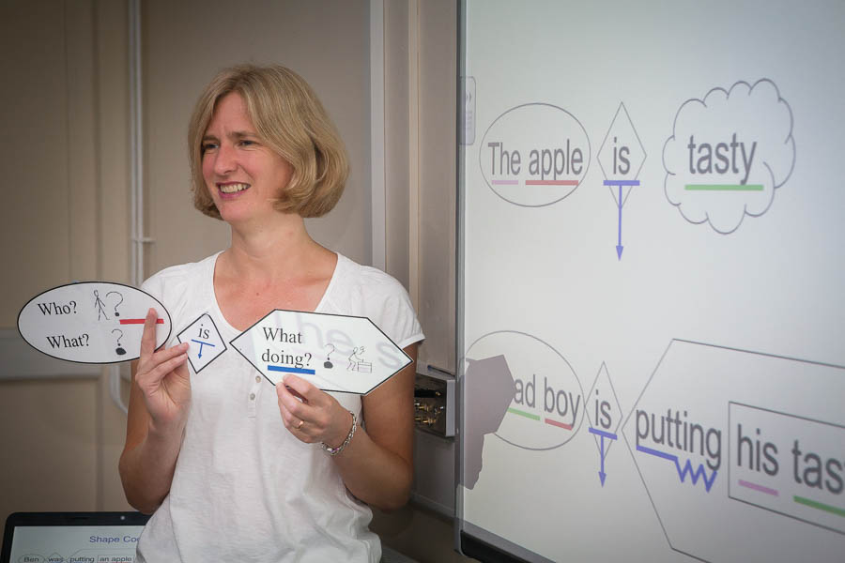
Shape coding
A Critique
By Rebecca Horner
Notes:
Introduction – who I am, what I am doing.
What do people know? Anyone to share ideas?

Slide 2


overview
The what, when’s, how’s and who’s of shape coding
The why’s of shape coding
Exploration of underpinning psychology
Exploration of the evidence of intervention impact
Questions

Slide 3

What have shapes got to do with literacy?
1. Method developed by Susan Ebbels to help children with specific language impairment (SLI) to develop their literacy skills.
2. Evidence suggests that children with language difficulties benefit from the specific teaching of grammar rules, as they may not have learned language implicitly in the normal way.
3. Children with language difficulties appear to benefit from the use of shape and colour as a visual means of understanding grammar rules
What evidence?
Dr. Susan Ebbels – Moorhouse School
What evidence?
Notes:
Susan Ebbels – worked as a speech & language therapist, completed a PhD with UCL & now works as Moorhouse Schools Research and Development coordinator. She is responsible for training and supporting the therapy department in critically appraising research and carrying out intervention studies. She is also an expert advisor to the Royal College of Speech and Language Therapists on school-aged children with language difficulties.
So this is a woman who probably knows her field quite well!
Point 2: Research she, and others, have carried out demonstrates …
Point 3: Children with language difficulties could benefit from the use of shape and colour as a visual means of understanding rules – often their memory for the visual is much better than their memory for the verbal.

Slide 4
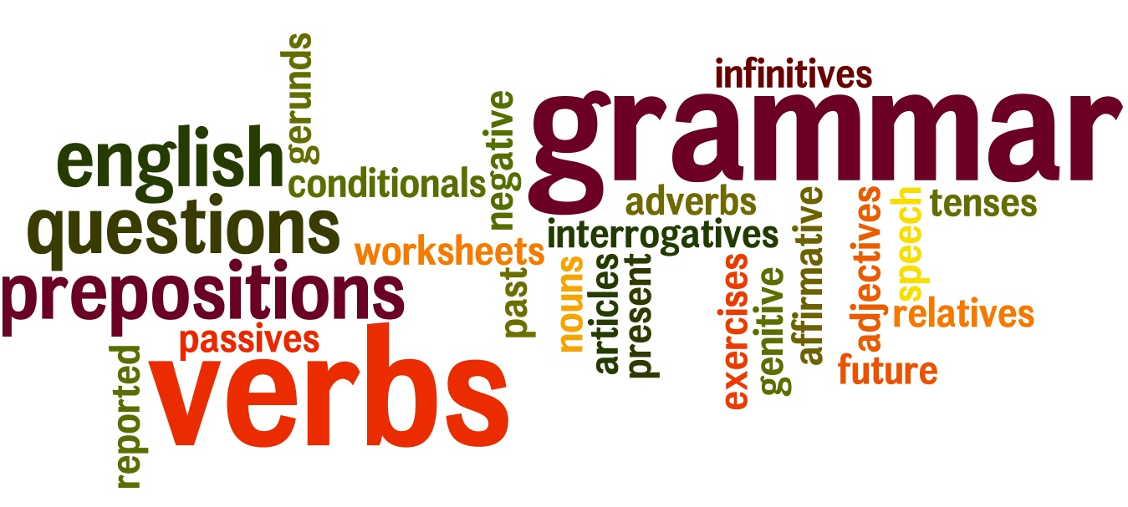
How does it work?
This visual coding system uses:
-colours (parts of speech)
-arrows (verb morphology, tense and aspect)
-shapes (Drawn in black around phrases)
It has been used to teach children:
Parts of speech
Noun-verb agreement
Past vs present tense
Passive vs active sentences
Embedded structures
Conjunction
Verb argument structure
Dative sentences
Questions
Notes:
If questioned: Dative case – a noun or pronoun is in the dative case when it is used as an indirect object. I.e. Oma gave me a puppy see: http://www.dailywritingtips.com/what-is-dative-case/

Slide 5
Shape coding - colours
Noun/Pronouns (girl, desk, I)
Determinative/Possessive pronouns (the, a, my)
Verb (pull, hit)
Adjective (happy, soft)
Preposition (in, through)
Adverb (swiftly, loudly)
Coordinating conjunction (and, but, or)
Subordinating conjunction (because, if)
Notes:
These have been slightly altered since the 2007 Ebbels paper due to the difficulty of getting yellow to show up on white paper or on a whiteboard.
On hand out

Slide 6
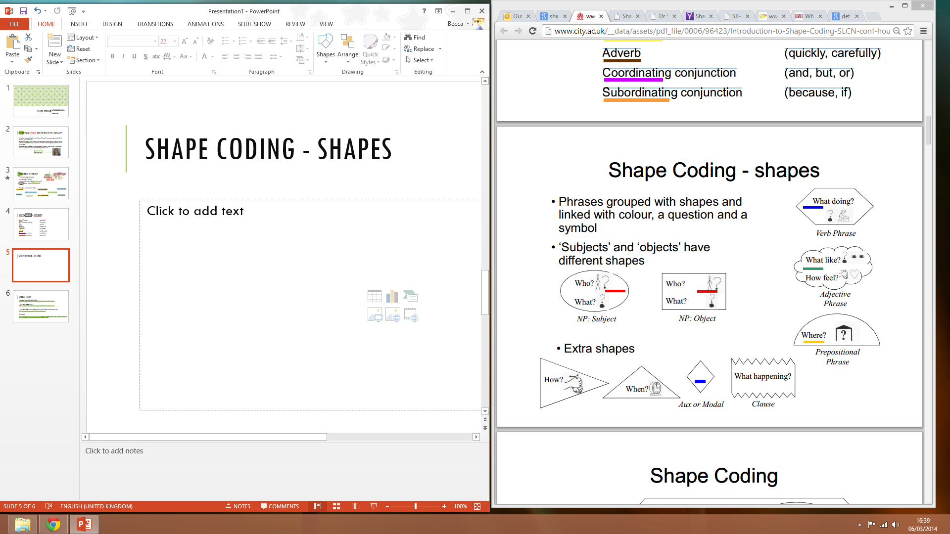
Shape coding - shapes
Use shapes to group phrases. Link with a colour, question and symbol.
Note that subjects and objects have different shapes
is, has, was
Images reproduced from Susan Ebbels original work. See references
Notes:
The rectangular shape for who/what will always be found inside another shape as part of a phrase – we will discuss & practice this more later on.
On hand out

Slide 7
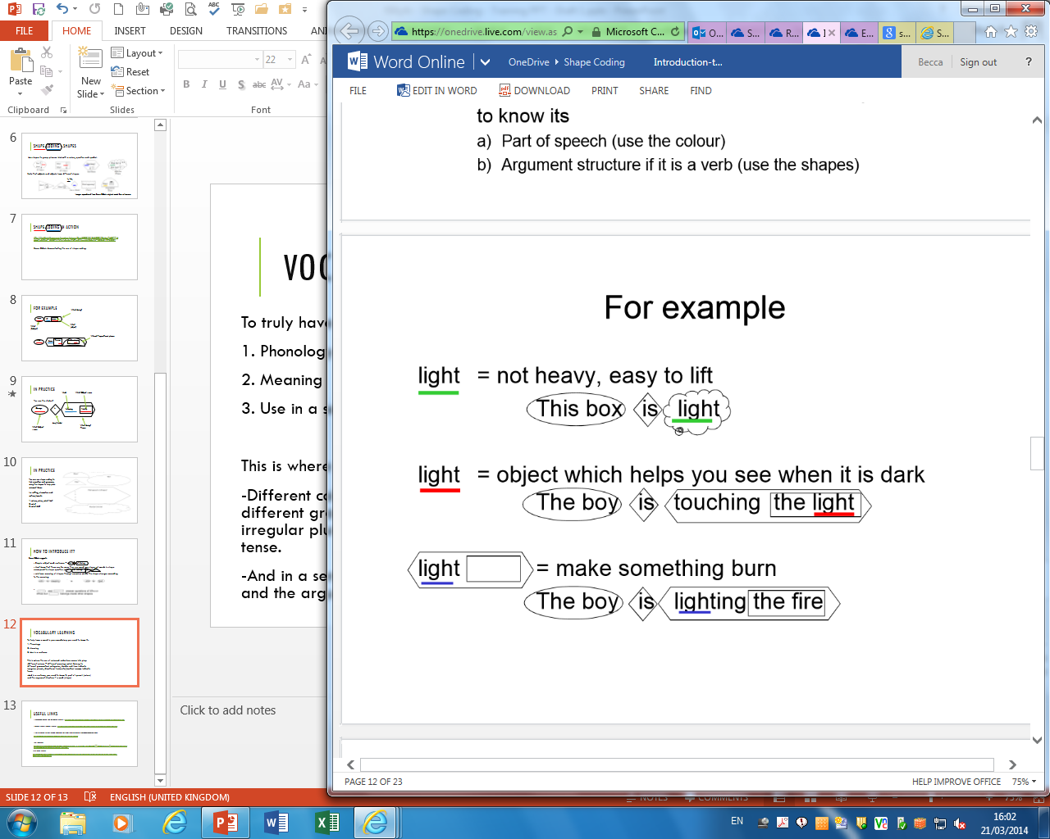
Vocabulary learning
Ebbels (2011)
Notes:
To gain full understanding pupils need to know how to read the word (its phonology), what it means and how it is used within a sentence. Coloured underlining helps with that.
This is where the use of coloured underlining comes
into play.
-Different colours = different meanings which belong to different grammatical categories, double lines indicate irregular plurals, directional horizontal/vertical arrows indicate tense.
-And in a sentence, you need to know its part of speech (colour) and the argument structure of a verb (shape)

Slide 8

Subject-verb agreement
Double red line = plural nouns Double blue lines = plural verb
The man
is
happy
The
men
are
happy
The man and the lady
are
happy
Notes:
Slide will be missing “is/men/are” at the beginning. Group to guess which words go in before revealing possible answers

Slide 9
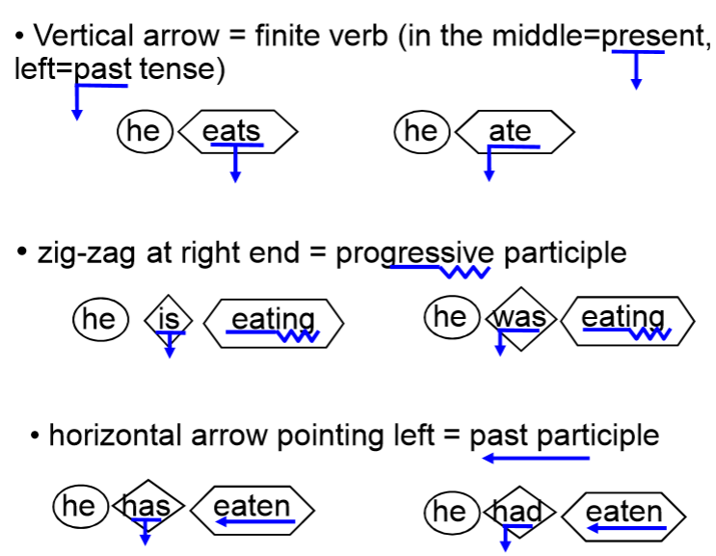
Verb Tenses
Notes:
Now we start getting a bit more complicated. Assuming the children have got the basics of shape and colour, we can now think about verb tenses.

Slide 10
Shape coding in action
http://link.brightcove.com/services/player/bcpid2201818662001?bckey=AQ~~,AAAAPmbRRLk~,C5G7jhYNtiefqbodph9K7nzSW_zsUUiE&bctid=2206019732001
Susan Ebbels demonstrating the use of shape coding. (10.05-14.00)
Notes:
View video clip from 10m 5s – 14m
If video clip doesn’t work, move on to practicing activities.

Slide 11
In practice
Verb
Who? Object - noun
George
is
following
Felicity
Aux/Modal
What doing? Phrase
Who? Subject - noun
Notes:
Again, blank to start with, group to complete hand out and share ideas before giving possible solution

Slide 12
In practice
Verb
Who? Object - noun
How?
George
is
sneakily
following
Felicity
Aux/Modal
Who? Subject - noun
What doing? Phrase
Notes:
Again, blank to start with, group to complete hand out and share ideas before giving possible solution

Slide 13
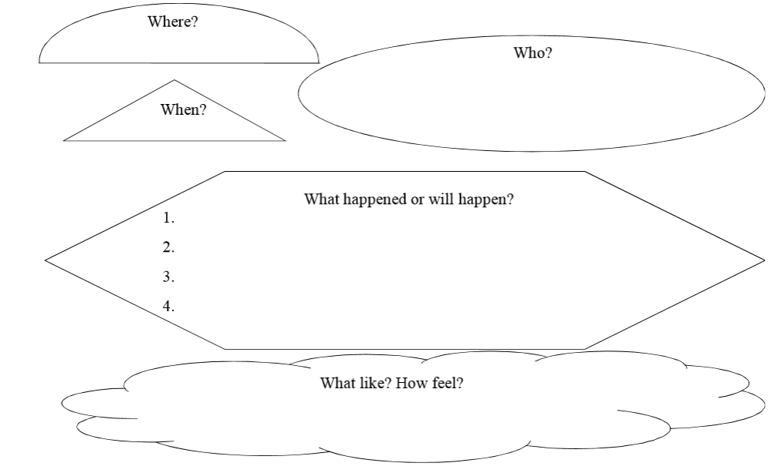
In practice
Notes:
Other ways to use principles of shape coding in school activities
You can use shape coding to link narrative and grammar, using the shapes to help plan relevant ideas:
i.e. setting, characters and actions/events.
1. where, when, what like?
2. who?
3. what did?
Students then use this plan to help them complete sentences for their story, either in a pre-set set of colour & shape coded boxes or onto a blank page and perhaps using coding to check back.

Slide 14
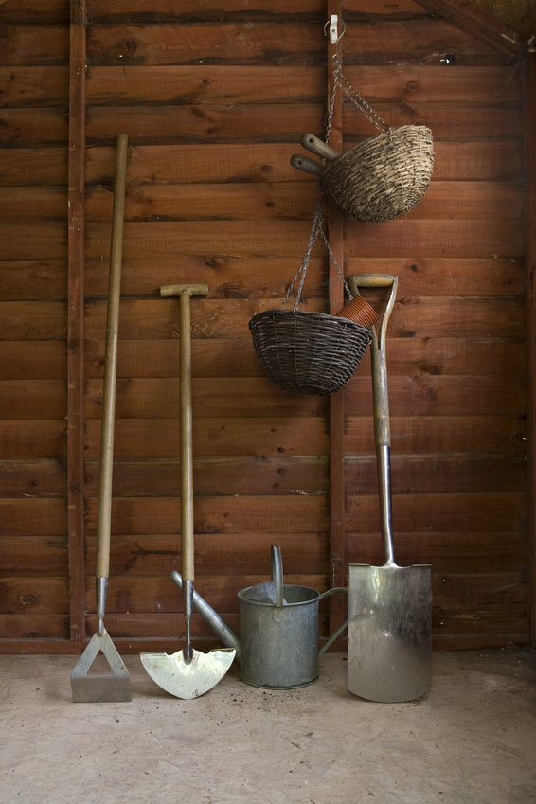
Note
- shape coding is not a programme: it’s a tool.
-gradual withdrawal of shapes is required to develop automatic use/understanding of grammatical structures
i.e. activities with shapes/colours, activities where shapes/colours are used only to check answers and activities with no shapes at all.
Notes:
Ebbels states that…

Slide 15
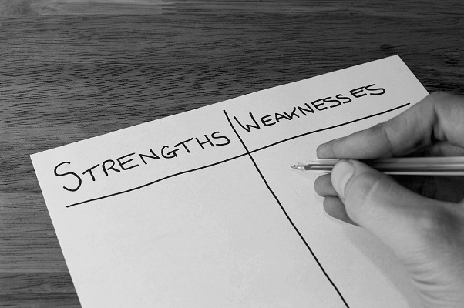
The Underpinning psychology
Notes:
Approaches that have attempted to teach grammar implicitly to children with speech and language impairments didn’t generally work, children made little or no progress and did not maintain any that they had made.
Previous approaches to teaching grammar assumed that children with speech and language difficulty have visual strengths and attempted to teach them language rules through these.
In a paper in 1965, Lea said that “colour-coding parts of speech (using her colour-coding scheme) could help children with “receptive aphasia” to produce written language despite limited comprehension & expressive language. Kaldor, Robinson & Tanner (2001) described the use of coloured shapes in their programme as aiding language development in children with SLO – BUT this evidence is anecdotal!
So, often visual cues are used with children with SLI to encourage & stimulate emerging language – still looking for evidence that supports this assumption though.

Slide 16
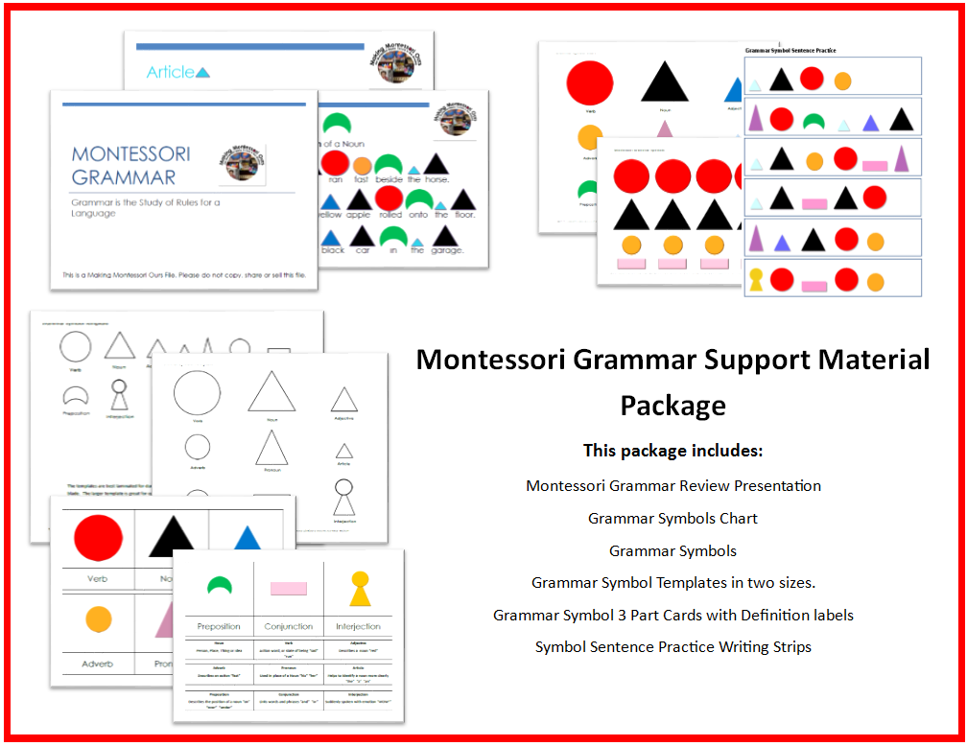
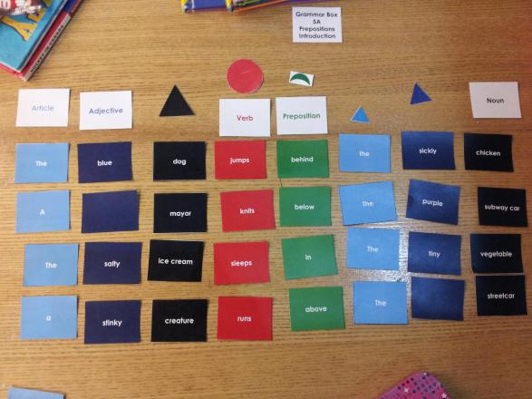
Notes:
Try teaching in usual implicit manner just increase the amount of teaching (I.e. Fey et al., 1993, 1997and Bishop et al., 2006).
Make the assumption that children with speech and language difficulties have visual strengths.
Realise that Montesorri was teaching grammar explicitly with visual methods in the early1900s and base your ‘new’ explicit visual method on his i.e.
Montessori grammar – lots of recent developments of this approach available – struggled to find original papers documents, mostly just citations of 1912 documents in modern papers.

Slide 17
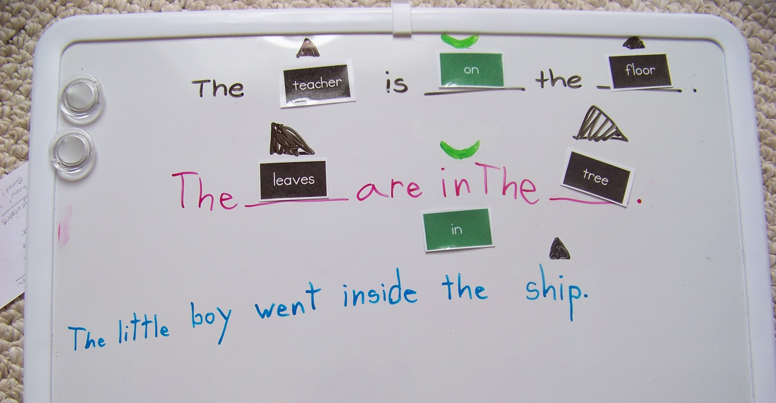
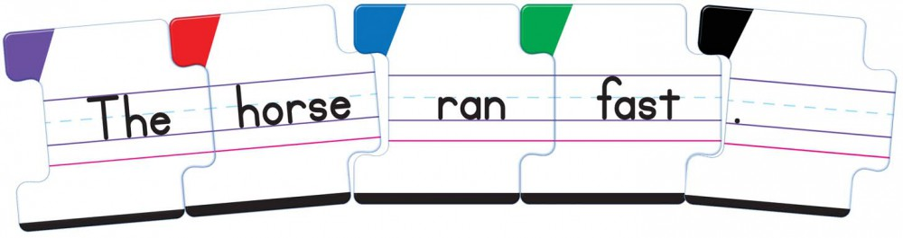
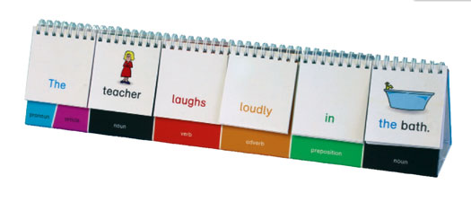
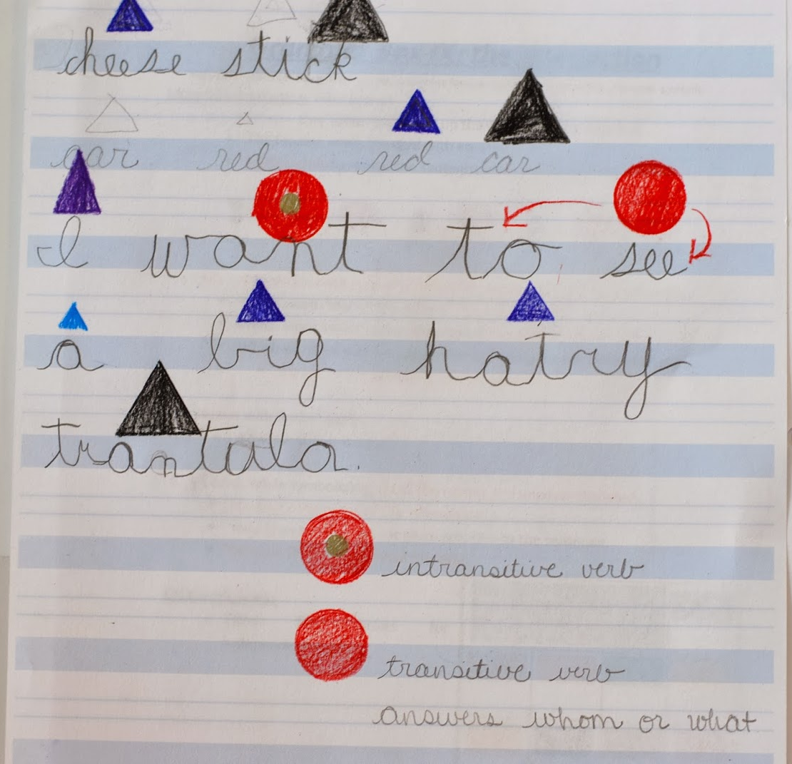
Notes:
The Colour Pattern Scheme, Lea 1965, 1970
Language Through Reading, Conn, 1973;
Zwitman and Sonderman, 1979;
Colourful Semantics, Bryan, 1997;
Spotlights on Language Communication System, Kaldor et al., 1999, 2001;
Language Through Colour, Gap House School, 2005

Slide 18

Notes:
Three reports describe case studies using the “Colourful Semantics” method:
Bryan’s (1997) original study showed a child’s age equivalent score on a simple test of expressive language improved by 12–18 months after only three months of intervention.
Spooner (2002) showed progress on formal language tests in two children
Guendouzi (2003) studied two children with SLI and found that one made some progress in expressive language while the other did not.
None of these case studies include experimental control and it is therefore difficult to know how much of the progress was directly related to the specific intervention method.
The other approaches are all limited to basic sentence structures. While this may be adequate for younger children with SLI, some older children need work on structures such as wh-questions, passives, conjunctions, tense, aspect and noun-verb agreement. None of the above systems are able to illustrate all of these structures.
So Ebbels designed shape coding as a method of explicitly teaching complex grammar rules.

Slide 19
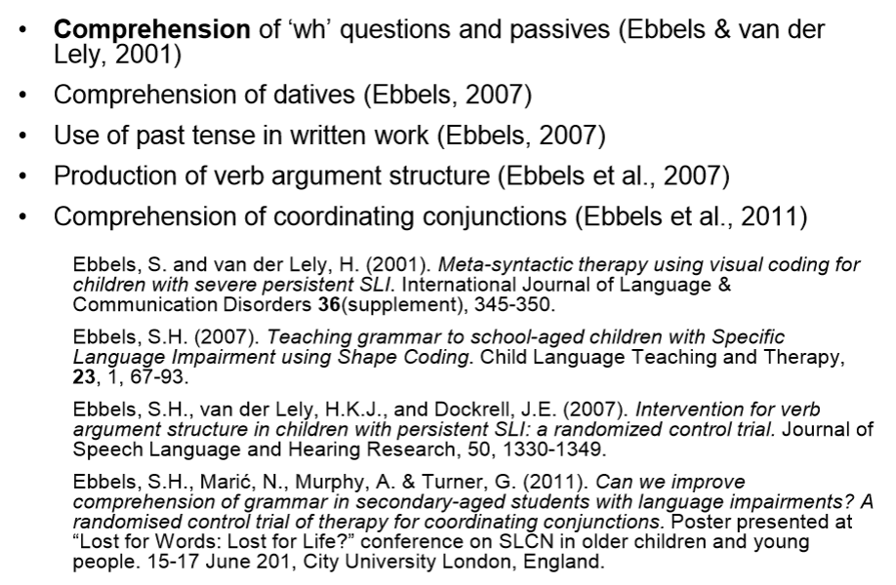
The underpinning evidence-base
Notes:
Ebbels delivers training on the shape coding method and cites the above (lifted from her presentation slides) as her evidence of intervention effectiveness.

Slide 20
The underpinning evidence-base
Year | Researcher | Participants | Age | Investigated? | Findings
2001 | Ebbels & van der Lely | 4 | 11-14 years | Efficacy of Shape Coding for improving expression & comprehension of passives & wh- questions | ¾ showed significant progress Maintained for 10 weeks All showed short-term progress with the production of wh- questions, but only one child maintained this at a significant level at follow-up. 3 who responded best participated in a follow-up 2/4 maintained progress made in comprehension & passives for 30 weeks But did not maintain progress in wh- questions
2007 | Ebbels, van der Lely & Dockerill | 27 | 12+ | Shape Coding V therapy focused on verb semantic representations V control therapy based on ‘inferencing’ | Both experimental groups made progress. Generalised to control verbs. Maintained for 3 months Control group made no progress
Notes:
Snapshot of type of research carried out using the shape-coding intervention

Slide 21
The underpinning evidence-base
Year | Researcher | Participants | Age | Investigated? | Findings
2007 | Ebbels | 3 (study 1) 4 (study 2) 9 (study 3) | 12-14 | Follow up of 2001 case studies targeting comprehension of dative structure & wh- comparative questions and further development | All 3 received intervention on datives, but not wh- comparatives due to change in therapist. 2/3 showed significant progress in comprehension of datives 1/3 was believed to have STM difficulties which confounded results 2/3 taught wh- comparitives made sig. progress. 6/9 used past tense more often 2/9 made progress only when taught as a pair in additional intervention time. No control group

Slide 22
The underpinning evidence-base
Year | Researcher | Participants | Age | Investigated? | Findings
2011 | Ebbels, Maric, Murphy & Turner | 14 | Secondary | The impact of shape-coding on secondary school-aged children with LI. Comprehension of coordinating conjunctions in a randomized control trial with a blind assessor | Progress for both groups (experimental plus “waiting” control) in specifically targeted conjunctions., which was maintained over short amount of time. .
Notes:
Delivered 1-2-1 by S&L Therapists.
Small group.

Slide 23
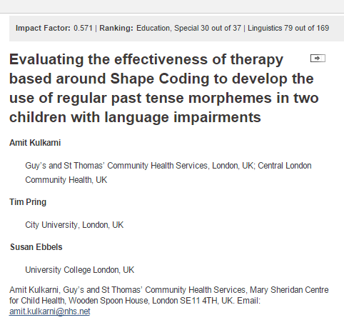
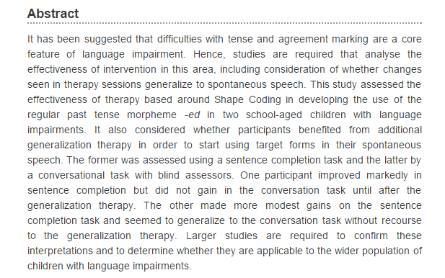
Notes:
Research on Ebbels Shape-coding has been generally carried out by Ebbels herself, including where she delivered the intervention directly to her participants. The case study method has been used often and even in recent research the outcome is that larger studies are required.
Additionally, each case-study appears to measure the impact of the intervention on different aspects of grammar, which makes it difficult to decipher whether shape-coding has a good general impact or whether shape-coding is only useful for teaching certain aspects of grammar i.e tenses or wh- questions.

Slide 24
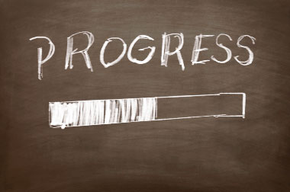
Notes:
Indications suggest that progress can be made using Shape-Coding, and that it can be maintained for varying periods. But does not usually continue after intervention has stopped.
Further research required to explore the relationship between the degree of progress and maintenance and whether it is easier to maintain progress for some targets than for others. (i.e. wh- questions, dative case, passives etc.)
In summary, the idea of coding grammar using colour and shape to teach it explicitly is based on the assumption that children with language impairment have visual strengths – I am still researching the evidence that supports this assumption, I think what is likely is that children with language impairment appear to learn better with visual cues BECAUSE they don’t have the language to learn in an auditory fashion as is more commonly used in our classrooms.

Slide 25

Useful links
- discussion forum run by Susan Ebbels - https://groups.yahoo.com/neo/groups/shapecoding/conversations/messages
- Link to Susan Ebbels school website and their shape-coding courses/resource shop
http://www.moorhouse.surrey.sch.uk/shape-coding-course
-Full vodcast
http://link.brightcove.com/services/player/bcpid2201818662001?bckey=AQ~~,AAAAPmbRRLk~,C5G7jhYNtiefqbodph9K7nzSW_zsUUiE&bctid=2206019732001
-PPT from Susan Ebbels
http://www.city.ac.uk/__data/assets/pdf_file/0006/96423/Introduction-to-Shape-Coding-SLCN-conf-hout-Compatibility-Mode.pdf

Slide 26


Slide 27
(Some) References
Ebbels & van der Lely (2001) Meta-syntactic therapy using visual coding for children with severe persistent SLI. International Journal of Language and Communication Disorders 36, 1; pp. 345-350
Ebbels (2007) Teaching grammar to school-aged children with specific language impairment using Shape Coding. Child Language Teaching and Therapy 23,1; pp. 67–93
Ebbels, van der Lely & Dockrell (2007) Intervention for verb argument structure in children with persistant SLI: A randomised control trial. Journal of Speech, Language and Hearing Research 50, pp.1330-1349
Norbury, Tomblin, Bishop (2008) Understanding Developmental Language Disorders: From theory to practice. Psychology Press

